Slide 1

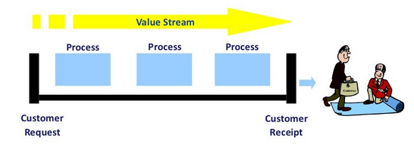
The Technology Value Stream

Slide 2


Technology Value Stream
The Technology Value Stream is the process to covert business hypothesis into a technology enabled service that delivers value to the customer.
In DevOps, technology value streams can credit its origins to Lean Methods in manufacturing, employed to accelerate software development agility.
This begins when engineers check in changes to version control and ends when that change is successfully in production.

Slide 3
Lean Principles
The central tenants of lean include:
That manufacturing lead time required to convert raw materials into finished goods is the best predicator of quality, customer satisfaction and employee happiness.
That the best predictors of short lead times is small batch sizes of work.
The other indicator to lean performance in processing time, also known as task time.

Slide 4
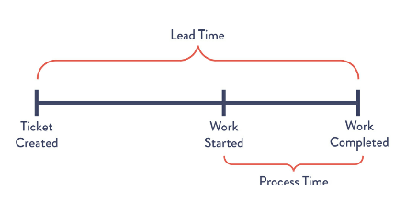
Lead Time vs. Processing Time
Lead time is the clock that starts when a request is made and stops when it is fulfilled.
Process time only starts when we begin working on the request and omits the time the request spent waiting in the queue.
Managing the ratio of lead to processing time is a direct measure of efficiency.
To shorten lead times requires reducing the time tasks are spent waiting in queue.

Slide 5
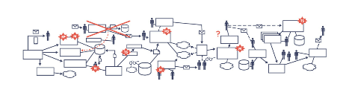
The common Scenario
In large, complex organizations deployment lead times are often best measured in months, quarters, or even years (rather than minues, hours, or days). This is dubbed the Common Scenario.
Causes:
Using outdated, monolithic systems
High reliance on manual testing resulting and long test times.
Multiple layers or approval required to move to the next stage

Slide 6

The Common Scenario
Results of long lead times
Code that doesn’t work when merged.
Further fixing of problems or having to redesign for new problems that cropped up during the initial development phase.
Frustrated developers – not knowing who broke the code or how to fix.
Frustrated customers.
Further backlog of work extending lead times for other projects waiting in queue.

Slide 7
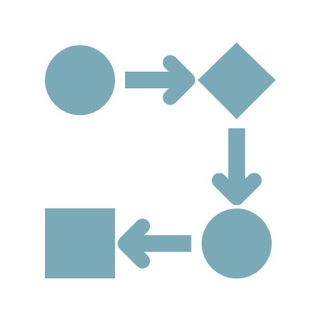
DevOps Ideal
Ideal:
Developers receive fast, constant feedback on work enabling them to quickly implement, integrate, and deploy code to production environment.
Lead time measured in minutes or hours.

Slide 8
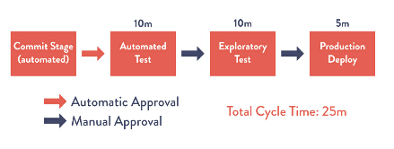
DevOps Ideal
Achieved via:
Continually checking small code changes in.
Perform automated testing of checked in code and deploy code into production
Architecture that is modular and coupled to small teams working with high degree of autonomy.

Slide 9
Conclusion:
Technology Value Streams:
Focus on reducing lead times by working in smaller chunks
Manage ratio of lead to processing time to gauge and improve efficiency. Keep work in smaller batches to short queue times.
Continually check in and test code.
Keep architecture modular and use small autonomous teams.

Slide 10
Conclusion:
Results:
High degree of confidence that changes will operate as designed and problems are quickly detected.
Ability to adapt to changing requirement quicky and easily.
Reduction of lead time leads to higher customer satisfaction.
Sources:
Kim, Gene; Humble, Jez; Debois, Patrick; Willis, John; Forsgren, Nicole. The DevOps Handbook (p. 58). IT Revolution Press. Kindle Edition.
https://insights.sei.cmu.edu/blog/taking-devsecops-to-the-next-level-with-value-stream-mapping

